Slide 1
the Actuarial Career
Kelly McManus, FSA
John Hancock Financial Services

Slide 2
What Is An Actuary?
“Actuaries are highly sought-after professionals who develop and communicate solutions for complex financial issues.”

Slide 3
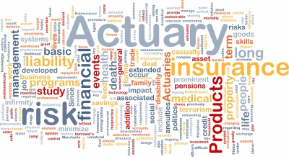
What Do Actuaries Do?

Slide 4
Where Do Actuaries Work?
Insurance
Life Insurance
Health Insurance
Other
Banking
Investments
Property-Casualty
Consulting
Government

Slide 5
Life, Health, Annuities, General Insurance, Investments
9,849 Associates
5,729 Fellows
Property and Casualty
2,206 Associates
4,709 Fellows

Slide 6
How to Become an Actuary
Preliminary Exams
5 Exams
Fundamentals of Actuarial Practice Modules
8 Modules
1 Interim Assessment
1 Final Assessment
Associate Professionalism Course
Half Day Course
Fellowship Exams
Core Exam (5 Hour)
Advanced Exam (5 Hour)
Risk Exam (2 Hour)
Fellowship Modules
Financial Economics
Enterprise Risk Management
Regulation and Taxation
Fellowship Admission Course
3 Day Course

Slide 7
How to Become an Actuary
P | Probability | Law of total probability, Bayes' theorem, discrete and continuous distributions, univariate and multivariate distributions, basic knowledge of insurance and risk management

Slide 8
How to Become an Actuary
P | Probability | Law of total probability, Bayes' theorem, discrete and continuous distributions, univariate and multivariate distributions, basic knowledge of insurance and risk management
FM | Financial Mathematics | Basic interest theory, annuities, bonds, loans, cash flows, portfolios, immunization, and financial derivatives, options, hedging, investment strategies, forwards, futures, and swaps

Slide 9
How to Become an Actuary
P | Probability | Law of total probability, Bayes' theorem, discrete and continuous distributions, univariate and multivariate distributions, basic knowledge of insurance and risk management
FM | Financial Mathematics | Basic interest theory, annuities, bonds, loans, cash flows, portfolios, immunization, and financial derivatives, options, hedging, investment strategies, forwards, futures, and swaps
MFE | Models for Financial Economics | Interest rate models, rational valuation of derivative securities, and risk management techniques

Slide 10
How to Become an Actuary
P | Probability | Law of total probability, Bayes' theorem, discrete and continuous distributions, univariate and multivariate distributions, basic knowledge of insurance and risk management
FM | Financial Mathematics | Basic interest theory, annuities, bonds, loans, cash flows, portfolios, immunization, and financial derivatives, options, hedging, investment strategies, forwards, futures, and swaps
MFE | Models for Financial Economics | Interest rate models, rational valuation of derivative securities, and risk management techniques
MLC | Models for Life Contingencies | Survival models, Markov chain models, life insurances and annuities, Traditional and Universal Life Models

Slide 11
How to Become an Actuary
P | Probability | Law of total probability, Bayes' theorem, discrete and continuous distributions, univariate and multivariate distributions, basic knowledge of insurance and risk management
FM | Financial Mathematics | Basic interest theory, annuities, bonds, loans, cash flows, portfolios, immunization, and financial derivatives, options, hedging, investment strategies, forwards, futures, and swaps
MFE | Models for Financial Economics | Interest rate models, rational valuation of derivative securities, and risk management techniques
MLC | Models for Life Contingencies | Survival models, Markov chain models, life insurances and annuities, Traditional and Universal Life Models
C | Construction and Evaluation of Actuarial Models | Severity models, frequency models, aggregate models, construction of empirical models, construction and selection of parametric models, estimating failure time and loss, determining the acceptability of a fitted model, credibility, simulation
Preliminary Exams

Slide 12
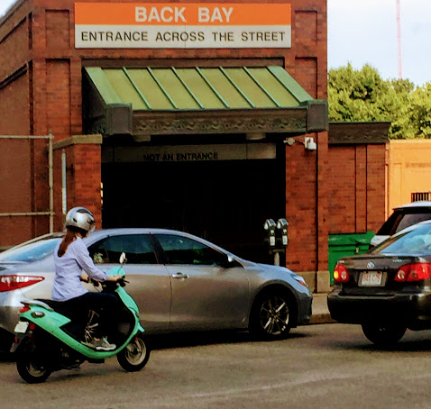
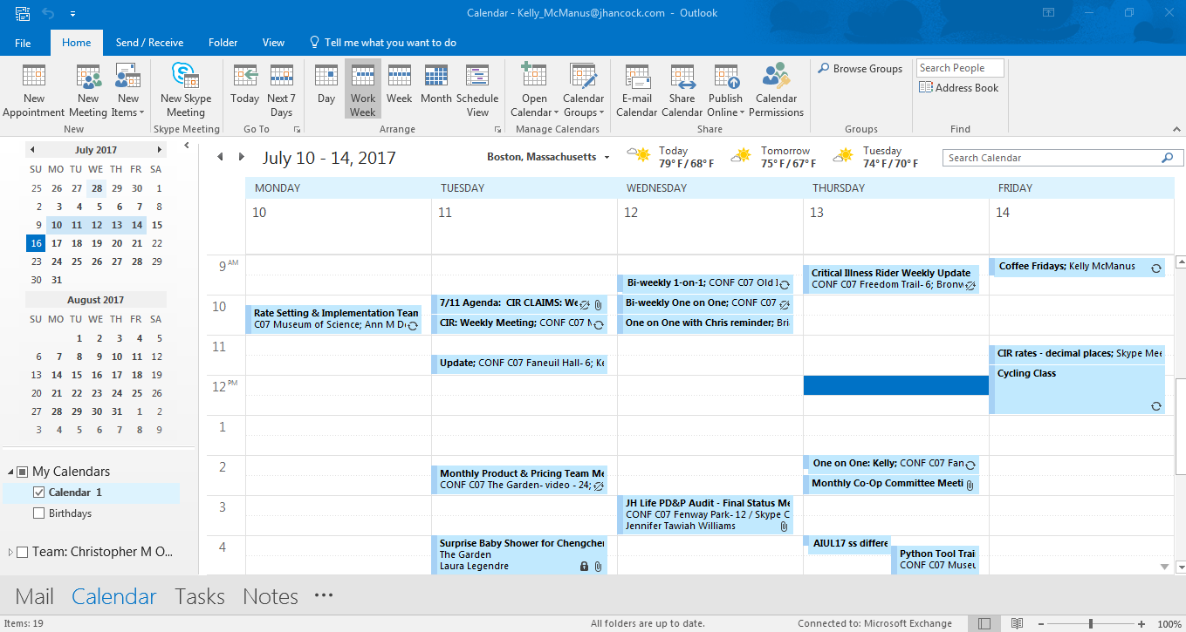
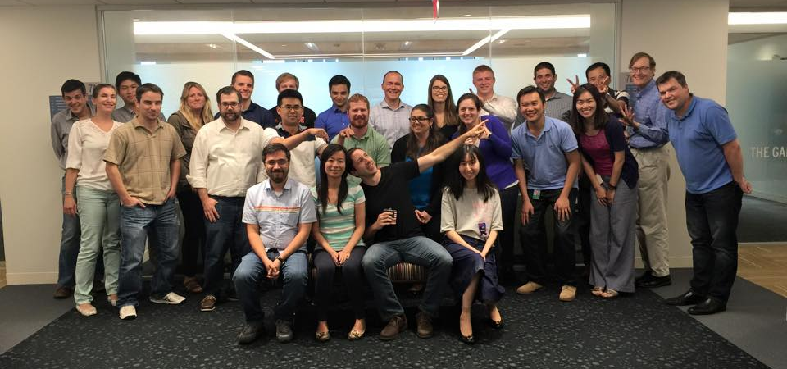
A Day in the Life
8:00 AM: Wake up
8:30 AM: Commute to work
9:00 AM: Greet coworkers, catch up on people's evenings from the night before, and settle in to the workstation
9:10 AM: Go through emails and respond accordingly. Glance at the calendar to plan out the day.
10:00 AM: Campus recruitment committee meeting
11:00 AM: Catch up with interns on project, ask if they have questions on current project
11:30 AM: One on One meeting with manager
12:00 PM: Lunch with a group of coworkers

Slide 13
A Day in the Life
1:30 PM: Catch up on emails, send out agenda for my 3 p.m. meeting
2:00 PM: Get status updates from resources on their projects and tasks. Revise/update digital agenda accordingly.
3:00 PM: Meet with internal Audit
4:00 PM: Starbucks
5:30 PM: Gym
6:30 PM: Commute home
7:00 PM: Dinner

Slide 14
Quick Facts: Actuaries
2016 Median Pay | $100,610 per year $48.37 per hour
Typical Entry-Level Education | Bachelor's degree
On-the-job Training | Long-term on-the-job training
Number of Jobs, 2014 | 24,600
Job Outlook, 2014-24 | 18% (Much faster than average)
Employment Change, 2014-24 | 4,400

Slide 15
Important Qualities
Analytical Skills
Math Skills
Communication
Skills
Interpersonal Skills
Computer Skills
Problem- Solving
Skills
Notes:
Analytical skills. Actuaries use analytical skills to identify patterns and trends in complex sets of data to determine the factors that have an effect on certain types of events.
Communication skills. Actuaries must be able to explain complex technical matters to those without an actuarial background. They must also communicate clearly through the reports and memos that describe their work and recommendations.
Computer skills. Actuaries must know programming languages and be able to use and develop spreadsheets, databases, and statistical analysis tools.
Interpersonal skills. Actuaries serve as leaders and members of teams, so they must be able to listen to other people’s opinions and suggestions before reaching a conclusion.
Math skills. Actuaries quantify risk by using the principles of calculus, statistics, and probability.
Problem-solving skills. Actuaries identify risks and develop ways for businesses to manage those risks.

Slide 16
Typical Student Programs
Study Hours
2 Year rotations
Exam raises
Bonuses with credentials
Seminars
Exam Materials
Celebrations

Slide 17
Insurance Product Pricing at John Hancock
Premium Calculations (Excel)
Financial Results (GGY Axis modeling)
Balance profitability and competitiveness
Analyze risk through sensitivities
Communicate to senior management

Slide 18
Sample Problem
An insurance company determines that N, the number of claims received in a week, is a random variable with P[N = n] = ¹/₂^{n+1}, where n > 0 . The company also determines that the number of claims received in a given week is independent of the number of claims received in any other week. Determine the probability that exactly seven claims will be received during a given two week period.
(A)¹/₂₅₆
(B)¹/₁₂₈
(C) ⁷/₅₁₂
(D) ¹/₆₄
(E)¹/₃₂

Slide 19
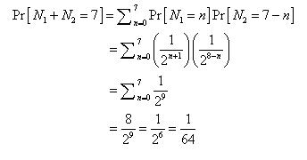
Solution: D
Let N₁ and N₂ denote the number of claims during weeks one and two, respectively.
Then since N₁ and N₂ are independent,

Slide 20
Questions
Kelly McManus, FSA
John Hancock Financial Services

